Slide 1
Concepts of Operating Systems
Atul Kahate

Slide 2
Session 1: Introduction to Operating Systems

Slide 3
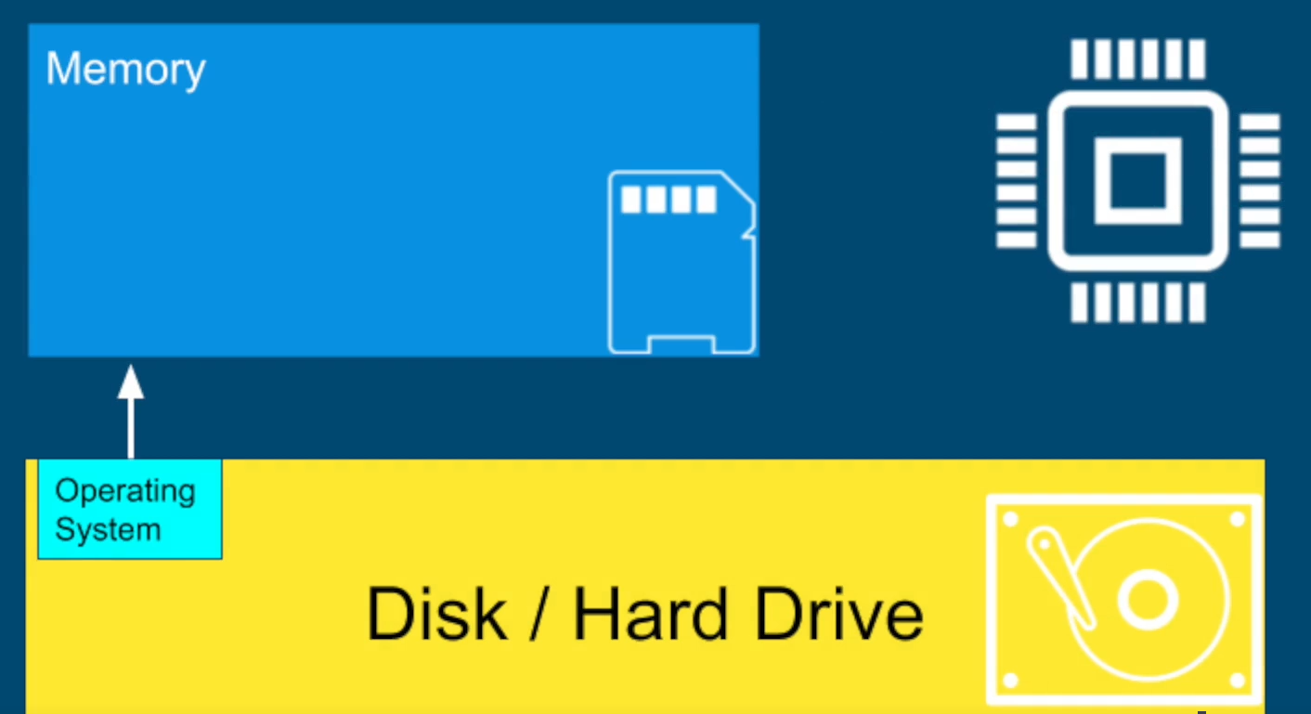
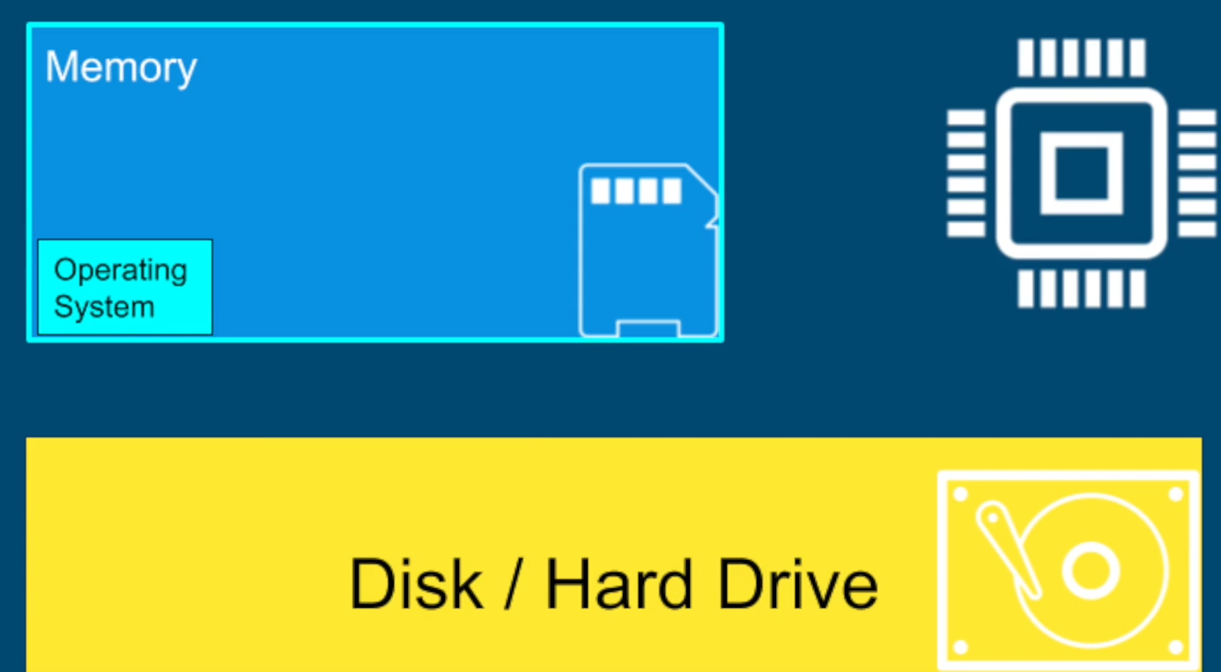
Why Operating Systems?
When we start our computer, a special program called operating system is loaded from the disk into the main memory (RAM) of the computer

Slide 4
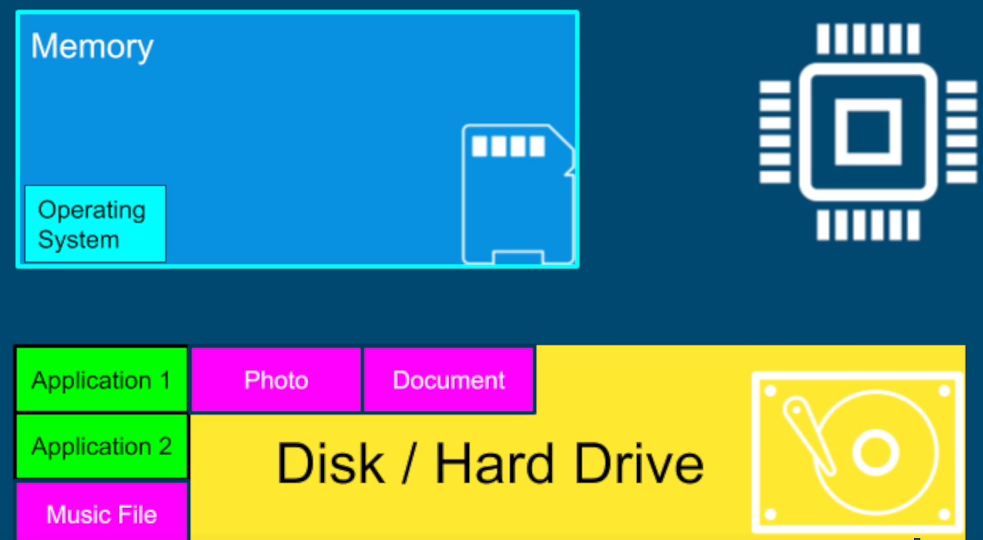
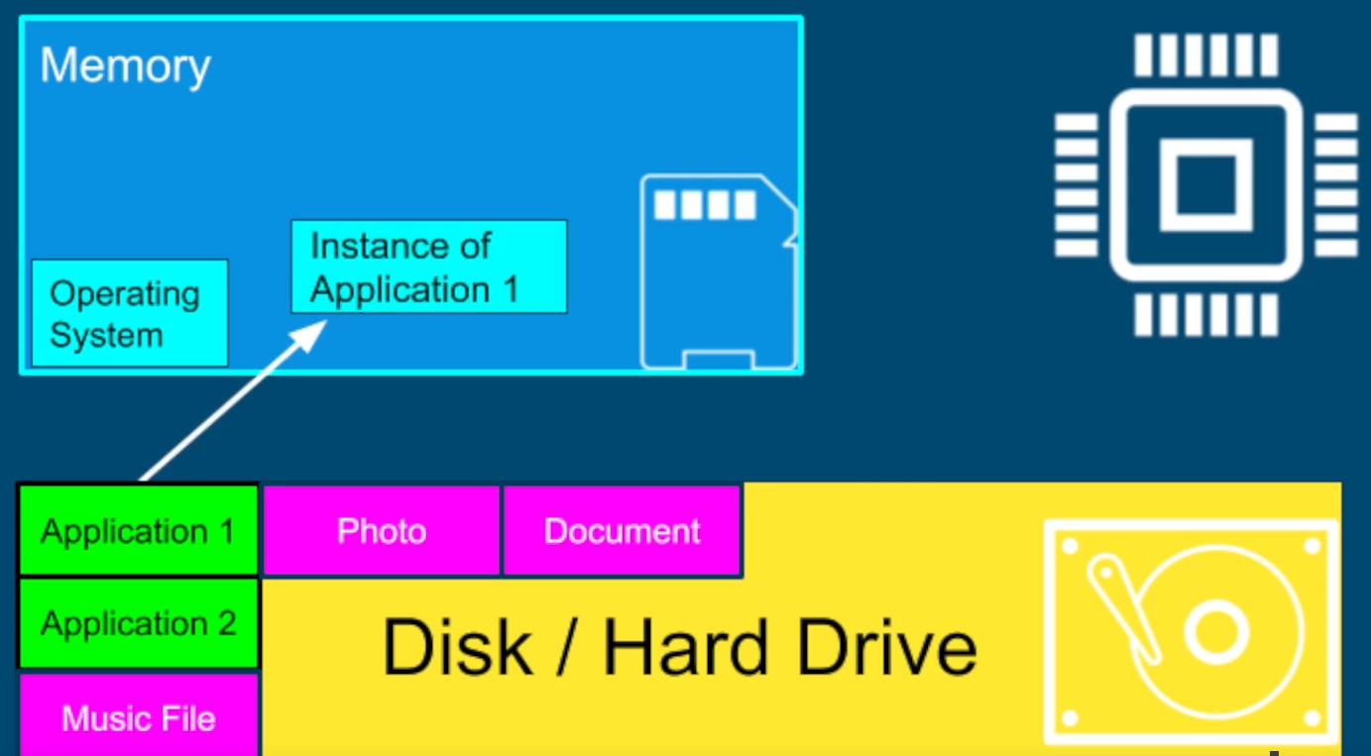
Why Operating Systems?
All our applications are on the disk in the form of files
When we run an application, it is loaded by the operating system into the main memory

Slide 5
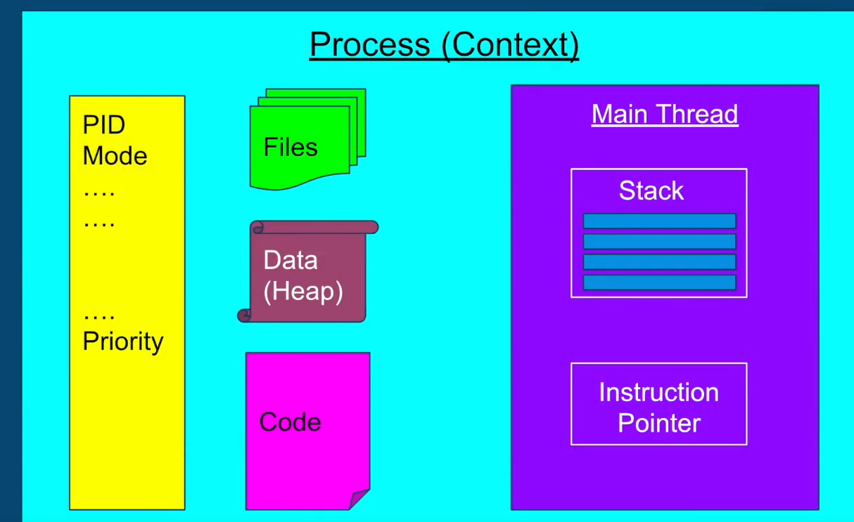
Why Operating Systems?
The instance of a program is a process

Slide 6
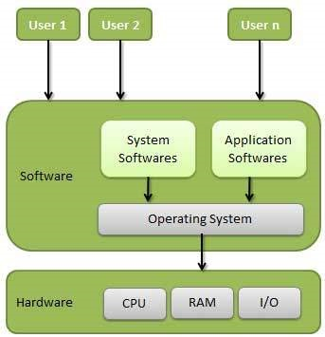
Introduction to OS Concepts
An Operating System (OS) is a program that acts as an intermediary between a user of a computer and the computer hardware.
Operating system goals:
Execute user programs and make solving user problems easier.
Make the computer system convenient to use.
Use the computer hardware in an efficient manner.

Slide 7
Operating System versus Application Software
Linux, Windows, Mac
Word, PowerPoint, Firefox
An operating system is like the entry point into a computer: This is where the computer wakes up.
The operating system is responsible for handling all the aspects pertaining to user programs, process management, memory management, disk management, working with the CPU, etc.
Application software makes use of an operating system for performing various tasks.
An application software allows the user to create presentations, play games, browse the Internet, etc.
An application software is specific, whereas an operating system is generic

Slide 8



Why are High-level Languages Portable?
Program written in C
C compiler for Windows
C compiler for Linux
C compiler for Mac
Execute
Execute
Execute

Slide 9
Why is OS Hardware-dependent?
We have two major choices when writing an OS:
Choice 1: Write the OS in the assembly language of the chosen hardware
Choice 2: Write the OS in a high-level language (such as C or C++ or Java)
Hardware-dependent
Hardware-independent

Slide 10
Option 1: Writing OS in Assembly Language
Assembly language is specific to the hardware (CPU)
Example: Assembly language for Intel x86 processors is different from the Assembly language for ARM processors used in smaller devices
Operating System written in Assembly language
Assembler
Hardware Level
(Machine Language)

Slide 11
Option 2: Writing OS in a High Level Language
If we write the operating system code in a HLL such as C++, we need to recompile it on each target environment
Now the OS is independent of the hardware
Operating System written in C++, give source code
Compile it on the target hardware
Hardware Level
(Machine Language)

Slide 12
Option 3: Writing OS in Java (Virtual Machine Environment)
If we write the operating system code a VM-based language such as Java, we can compile it only once anywhere and give the generated bytecode (object code), which can run on any machine in the world that has Java Runtime Environment installed
Operating System written in Java, do not give source code
Compile it on any machine to generate bytecode, give bytecode
Hardware Level
(Execute the bytecode on any machine that has JRE)

Slide 13
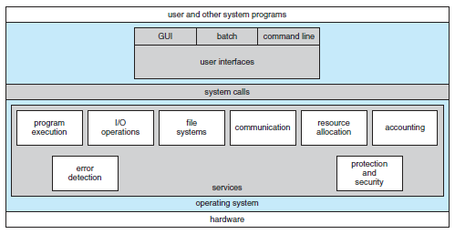
Different Components of an OS

Slide 14
Computer System Structure – 4 Components
Hardware – Provides basic computing resources
CPU, memory, I/O devices
Operating system - Controls and coordinates use of hardware among various applications and users
Application programs – Define the ways in which the system resources are used to solve the computing problems of the users
Word processors, compilers, web browsers, database systems, video games
Users - People, machines, other computers
See next slide for a diagram

Slide 15
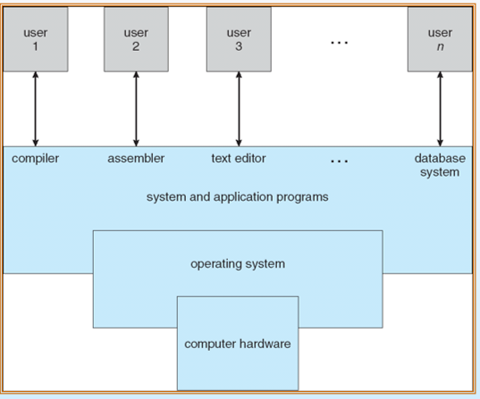
Computer System – Four Components

Slide 16
Examples of OS
Mobile OS: Android, iOS
Embedded Systems OS: Embedded Linux, QNX, VxWorks – Generally work on microwave ovens, TV, DVD, MP3 players, etc – Embedded in ROM
Real-time OS: eCos - Deadline-based work, Controlling machines, Welding robots, etc
Desktop OS: Windows, Linux, Mac – General-purpose OS
Server machine OS: Windows server/Linux server – Need to handle client-requests, load, security

Slide 17
Main Functions of Operating Systems
Provide abstraction to user programs
Managing computer resources
A modern computer consists of one or more processors, some main memory,
disks, printers, a keyboard, a mouse, a display, network interfaces, and various
other input/output devices. If every application programmer
had to understand how all these things work in detail, no code would ever
get written.
Managing these resources in itself is a huge task!

Slide 18
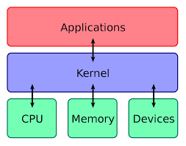
Kernel
“The one program running at all times on the computer” is the kernel.
Everything else is either a system program (ships with the operating system) or an application program.

Slide 19
User Mode and Kernel Mode (Diagram on Next Slide)
Most computers have two modes of operation: kernel mode and user mode.
The operating system runs in kernel mode (also called supervisor mode).
It has complete access to all the hardware and can execute any instruction that the hardware supports
The rest of the software runs in user mode, in which only a subset of the machine instructions is available.
Those instructions that affect control of the machine or do I/O (Input/Output) cannot be used

Slide 20
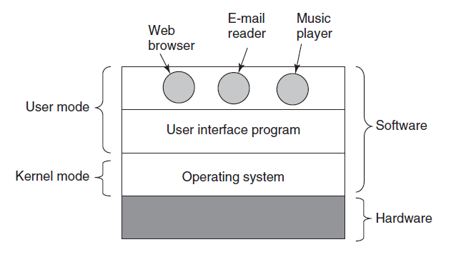
User Mode and Kernel Mode

Slide 21
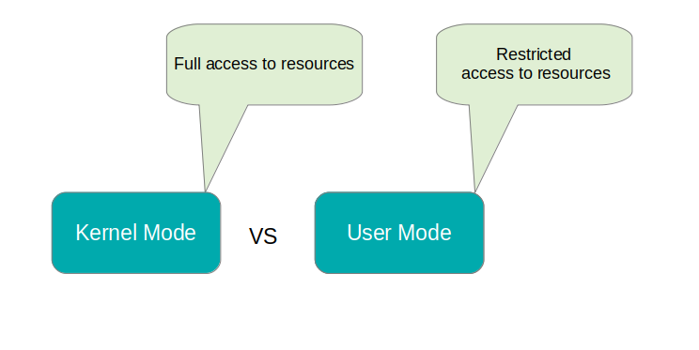
User Mode and Kernel Mode
User mode has restricted access to resources. Example: Text editor, Media player. If a resource such as disk or file is needed, a signal is sent to the CPU via an interrupt to switch to the kernel mode.
Kernel mode (also called as supervisor mode) has full access to memory, I/O, and other resources. Here, CPU has full access to the hardware and can execute any instruction.

Slide 22
User Space and Kernel Space
User space
Area of memory where all the user mode applications execute.
This memory can be “swapped out” when necessary.
Kernel space
Area of memory where all the kernel mode applications execute.
Strictly reserved for kernel background processes and has full hardware access.

Slide 23
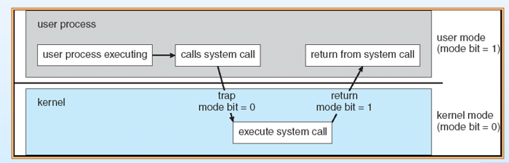
User Mode to Kernel Mode Transition

Slide 24
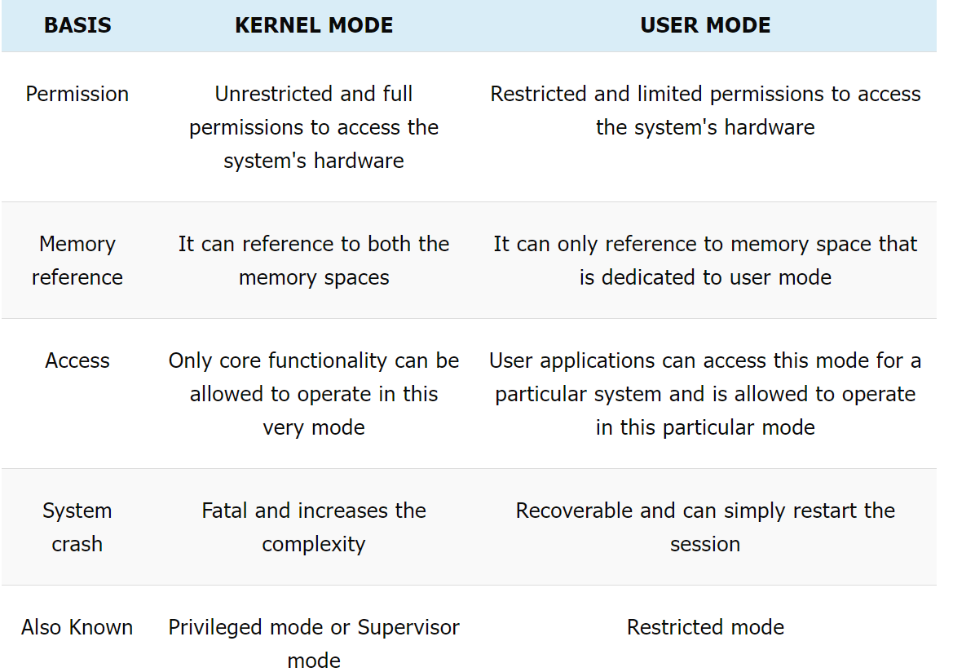
Kernel Mode versus User Mode

Slide 25
Interrupt
When the current processing needs to be temporarily stopped for handling some event of a higher priority, an interrupt is generated
Example: The operating system is reading a file and the user types something on the keyboard
This will generate a keyboard interrupt
The operating system will handle this interrupt (i.e. handle the processing related to the key) and then resume file reading

Slide 26
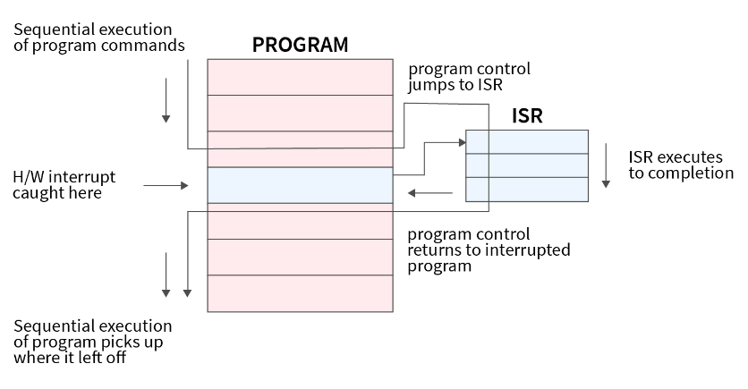
Interrupt Example

Slide 27
Handling interrupts
An interrupt is a signal sent by hardware or software to the processor for processing
The process that runs when an interrupt is generated is the interrupt handler
The CPU saves the state of the ongoing process and shifts its attention to the interrupt generated by giving access to the interrupt handler
This entire process is called interrupt handling
The interrupt handler is also known as Interrupt Service Routine (ISR)
ISR handles the request and sends it to the CPU
When the ISR is complete, the halted process is resumed

Slide 28
How does the CPU know which ISR to call?
Each type of interrupt is assigned a unique interrupt number
The interrupt number and its corresponding instructions set address (or process’s base address) are stored in a vector table known as Interrupt Vector Table (IVT), see next slide
Using the interrupt number and IVT, the CPU comes to know about the base address of the process that is needed to handle the respective interrupt
Now, the control is given to that process to handle the interrupt and this process is known as Interrupt Service Routine (ISR)

Slide 29
Interrupt Vector Table
Interrupt Number | Memory Address of Interrupt Handler Code
1 | abcd:pqrs
2 | wxyz:mnop
3 | lmno:stuv
… | …
… | …

Slide 30
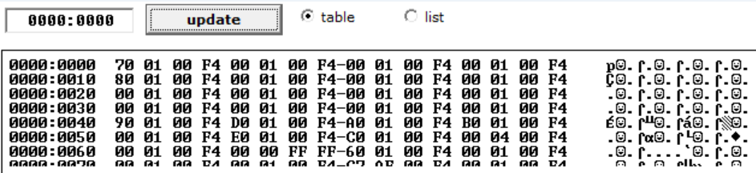
IVT in x86 Machines
Using the emu8086 emulator, open memory view and change the address to all 0s – the contents are the IVT

Slide 31

Understanding IVT
In the emu8086 emulator, type this code:
org 100h
int 0x00
ret
Emulate and Single step to run the int instruction
View-Memory, change address to 0000:0000
Check CS (Code Segment) and IP (Instruction Pointer) registers
They are the same as the first four bytes at memory address 0000:0000, which means the CPU is ready to execute the code for that interrupt now, at memory address F400:0170
Four addresses, respectively for interrupts 1, 2, 3, and 4 -
So, each interrupt entry takes four bytes
Little endian method is used, which means 70 01 is actually 01 70
Also, offset is stored first, then the segment (We will discuss in segmentation), so full address is F400:0170

Slide 32
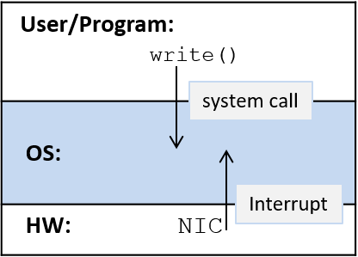
Interrupts and System Calls
Example: a Network Interface card (NIC) is a hardware interface between a computer and a network. When the NIC receives data over its network connection, it interrupts (or wakes up) the OS to handle the received data.
Requests to the OS also come from user applications when they need access to protected resources. For example, when an application wants to write to a file, it makes a system call to the OS, which wakes up the OS to perform the write on its behalf.

Slide 33
Interrupts: Demo
In C/C++, we would write this as:
putchar (‘A’);
Type the following program in the 8086 assembler emulator (emu8086v408), then press the Emulate button
org 100h
mov ah, 0eh
mov al, 'A'
int 10h
ret
org 100h = Load program in memory location 100 hex
mov ah, 0eh = Set the sub function for interrupt 10h to 0eh, which means show character on the screen – another example is 07h, which means scroll down, etc
mov al, ‘A’ = Specify the character to be displayed
int 10h = Now generate a software interrupt number 10h that executes the sub-function 0eh, i.e. show character on the screen
See https://faculty.kfupm.edu.sa/COE/shazli/coe205/Help/asm_tutorial_04.html

Slide 34
Interrupts Demo: Read a Character and Display it Back
org 100h
mov ah, 1h ; keyboard input subprogram
int 21h ; read character into al
mov dl, al ; copy character to dl
mov ah, 2h ; character output subprogram
int 21h ; display character in dl
ret
Note: Earlier we used interrupt 10h to display
However, interrupt 21h can be used for both input and output
For input, place a value of 1h in the ah register
For output, place a value of 2h in the ah register

